Slide 1
Kin Selection and Social Behavior

Slide 2
I. Motivation
Cooperative behaviors are widespread.
Why?
Notes:
Island example

Slide 3
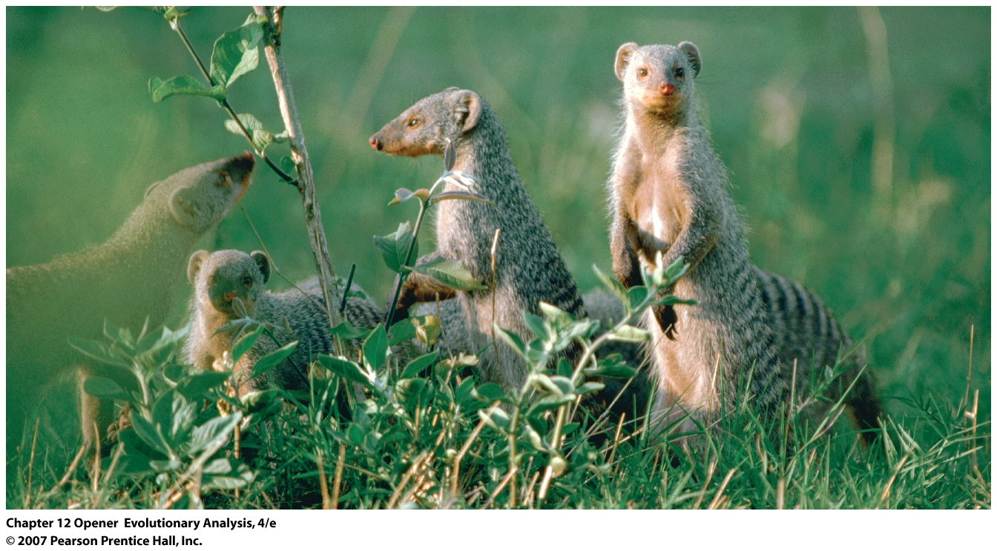
Genetically related female banded mongooses live and
breed in groups, and care for each other's young
Notes:
Chapter 12 Opener
Genetically related female banded mongooses live and breed in groups, and care for each other's young (Gilchrist 2004; Gilchrist et al. 2004; Hodge 2005).

Slide 4
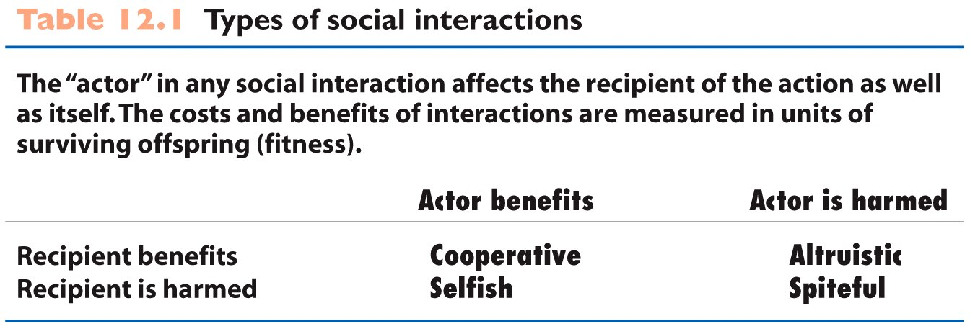
+, -
Actor
Recipient
Notes:
Table 12.1 Types of social interactions, THIRD PARTICIPANT WOULD GAIN FROM SPITEFUL BEHAVIOUR

Slide 5
II. Theory of Altruism
An individual’s survivorship and reproduction relative to other individuals in the population (Direct Fitness)
Hamilton’s Rule (1964):
Inclusive fitness =
Direct fitness + indirect fitness
Kin selection: natural selection favoring the indirect component of fitness
(Benefit x relatedness) – Cost > 0; Br > C; r > C/B
Benefit to recipient and cost to altruist
Relatedness: probability that homolgous alleles in 2 individuals are identical by descent

Slide 6
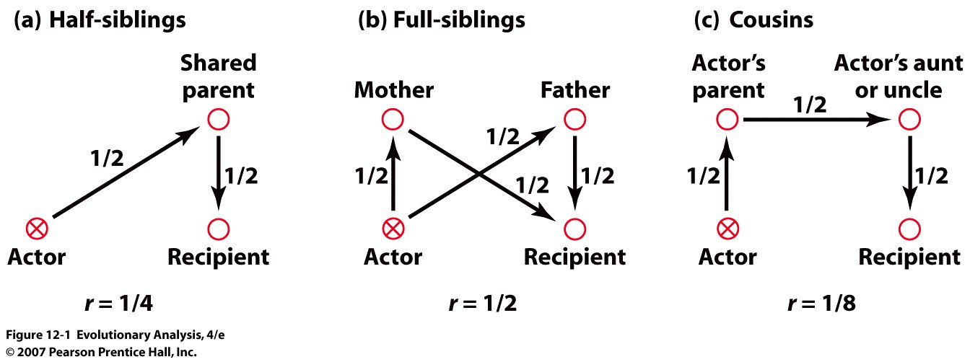
Indirect Fitness through a Relative
Computing relatedness with pedigrees
The arrows describe paths by which genes can be
identical by descent
Notes:
Figure 12.1 Computing relatedness with pedigrees
The arrows describe paths by which genes can be identical by descent. The text explains how these paths are used to calculate r, the coefficient of relatedness. Related to inbreeding coefficient but different by 1 generation
By performing an altruistic behavior on the recipient you help ¼, ½, 1/8 of your genes, or indirect fitness

Slide 7
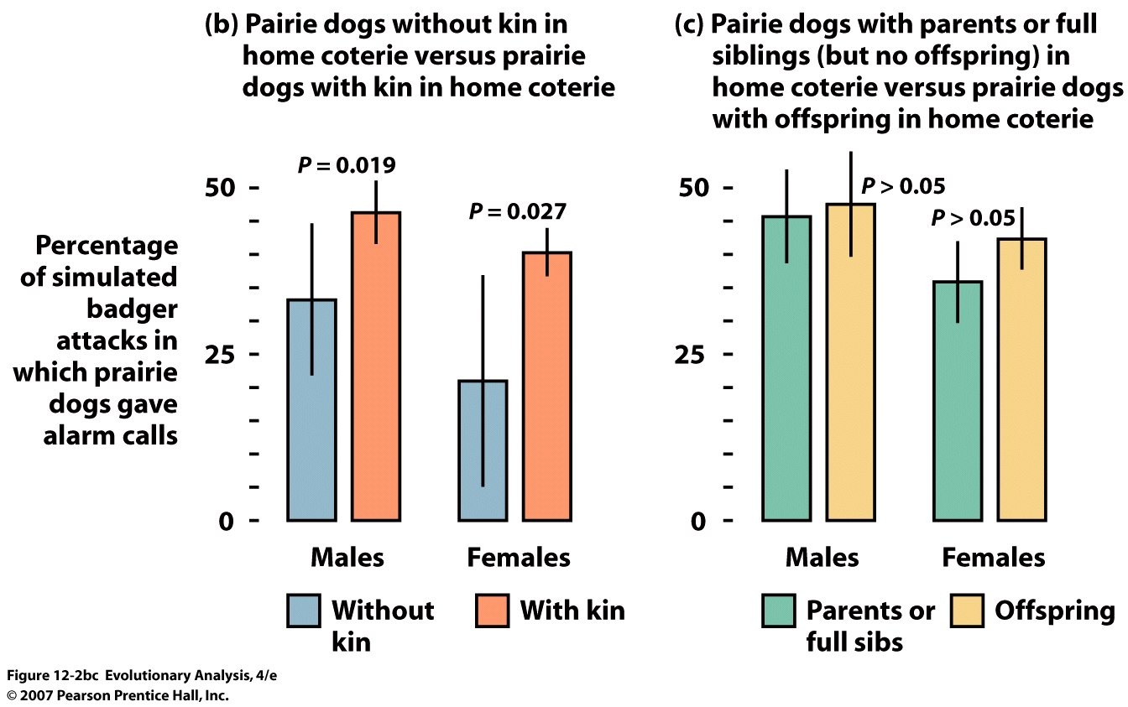
III. Evidence
Black-tailed prairie dogs give more
alarm calls when kin are nearby
Notes:
Explaining alarm calling in birds and mammals is a classical application of inclusive fitness theory
Figure 12.2bc Black-tailed prairie dogs give more alarm calls when kin are nearby
Experimental approach: (b) This bar chart reports the rates of alarm calling by prairie dogs who have vs. do not have kin living with them. Both sexes call more often when kin are near. (c) This chart reports the rates of alarm calling by males and females living with non-offspring kin vs. offspring. Both sexes call nearly as often when non-offspring kin are near as when offspring are near. Redrawn from Hoogland (1995). With Kin is not simply parental care compare b with c

Slide 8
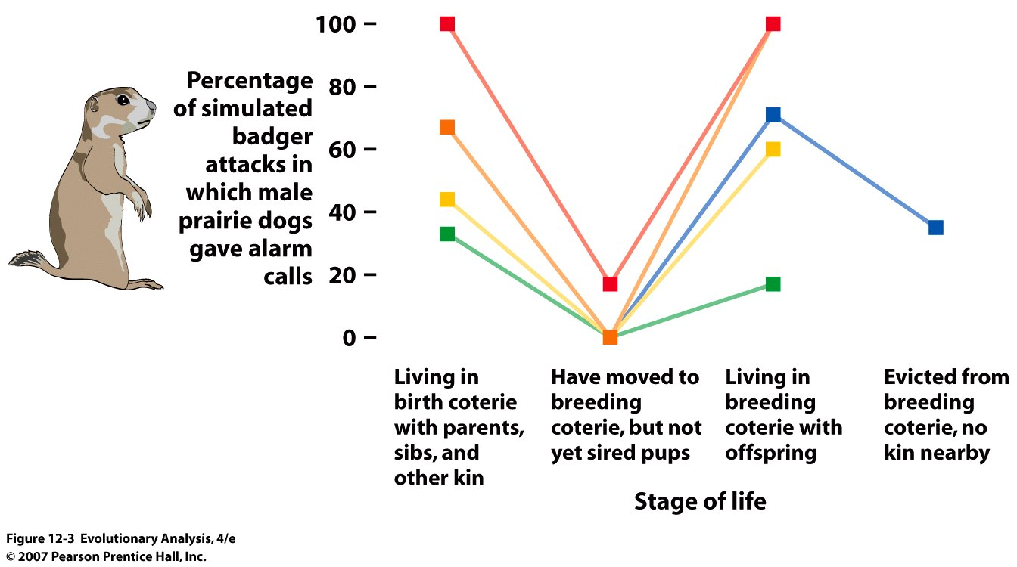
Male black-tailed prairie dogs change their alarm
calling behavior when their living situation changes
5 males
Notes:
Figure 12.3 Male black-tailed prairie dogs change their alarm calling behavior when their living situation changes
This graph plots the rate of alarm calling by five individual males at different stages of life. The males increased or decreased their rate of calling according to whether kin were nearby. Redrawn from Hoogland (1995).

Slide 9
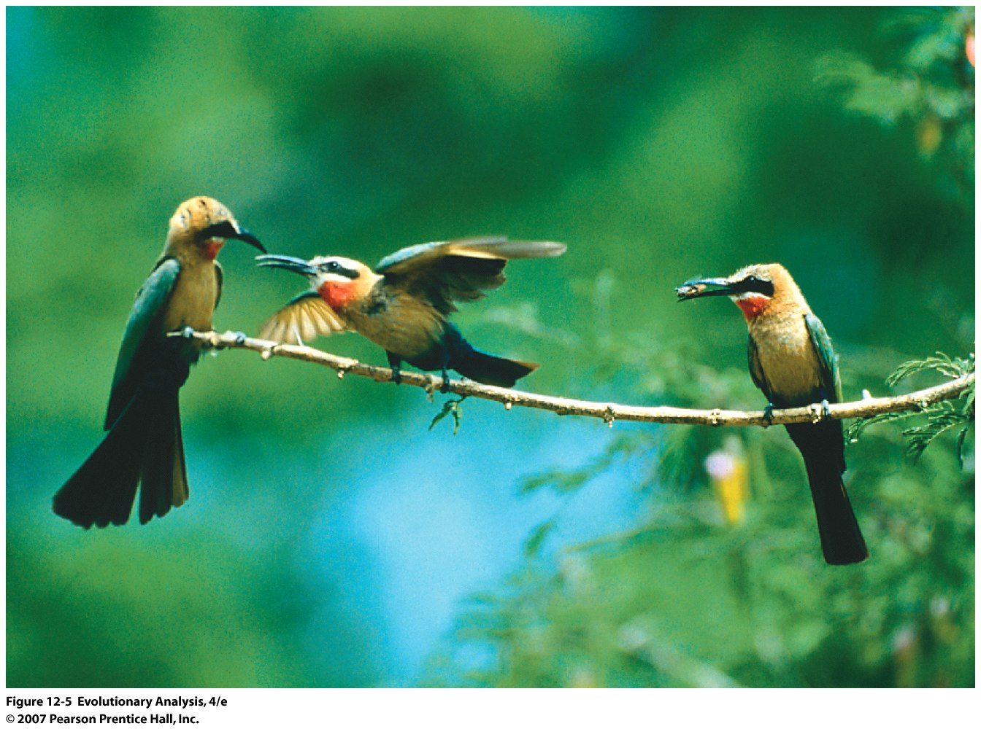
Helping Behavior in Birds:
White-fronted bee-eaters
Notes:
Figure 12.5 White-fronted bee-eaters
The individual in the middle is performing a wing-waving display and may be soliciting a feeding. East Africa

Slide 10
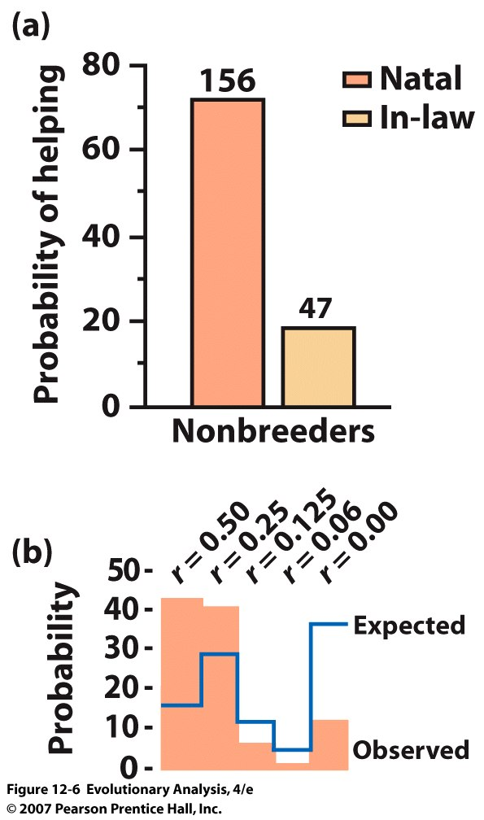
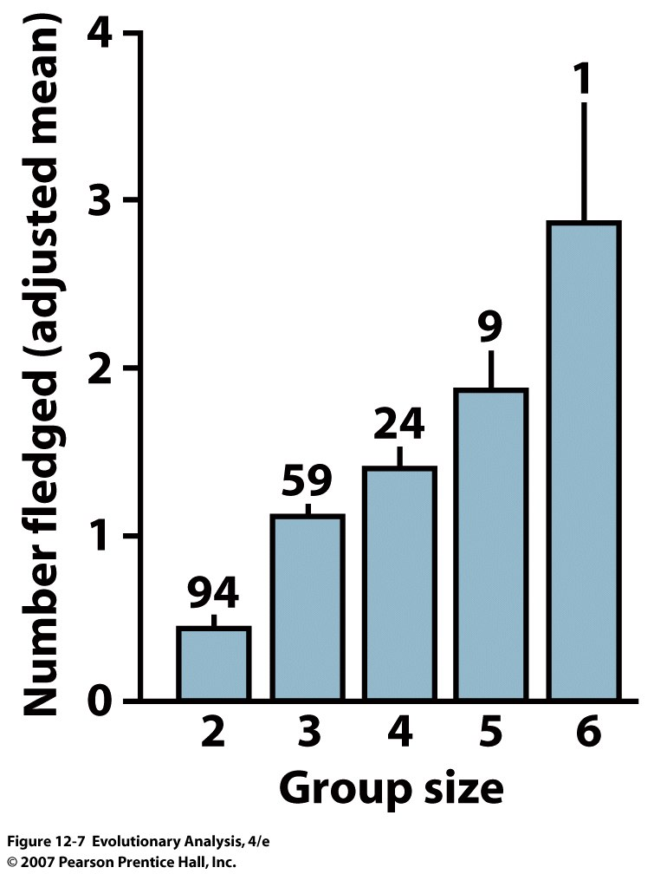
In bee-eaters, helpers assist
close relatives
Fitness gains due to helping
Notes:
Figure 12.6 In bee-eaters, helpers assist close relatives
(a) Bee-eater clans often contain nonbreeders that have paired with members of the clan. Their r with the offspring being raised that season is 0. This bar chart shows that they are much less likely to help than are clan members (P < 0.01). (b) In this bar chart, the expected probability of helping is calculated by assuming that helpers assist clan members randomly, in proportion to the r's of nestlings in clan nests. A G test rejects the null hypothesis that helping is directed randomly with respect to kinship (P < 0.01). From Emlen and Wrege (1988).

Slide 11
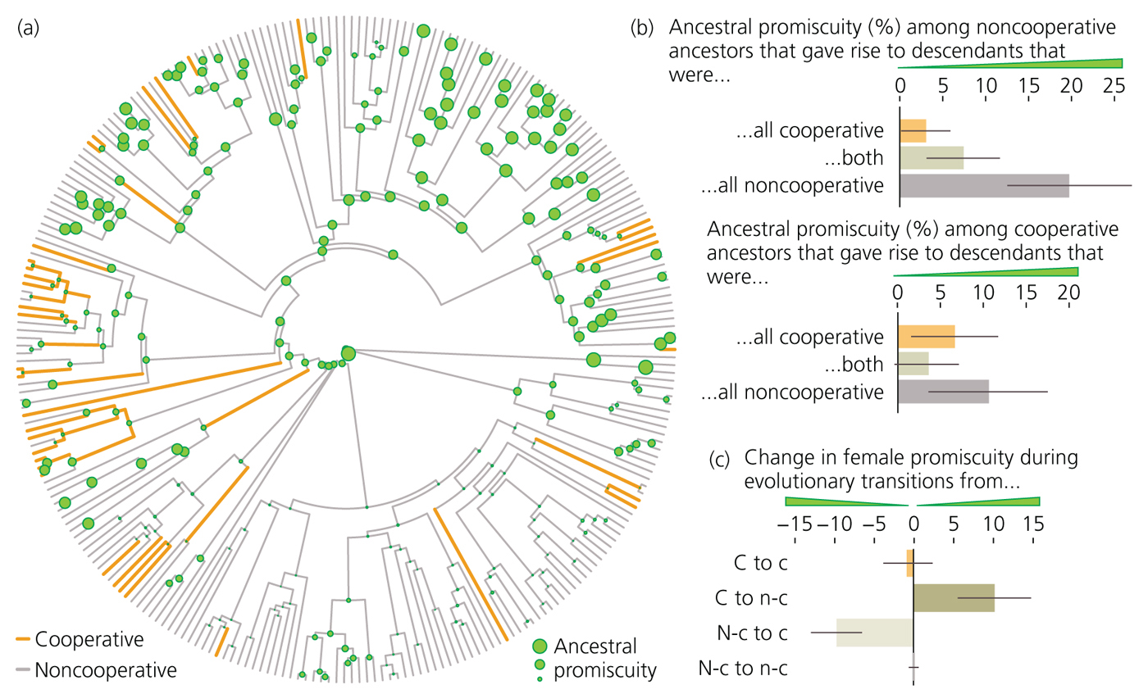
Figure 12-17
More related birds are the more likely they are to cooperate
Notes:
Also promiscuity increased with evolution of NC behavior

Slide 12
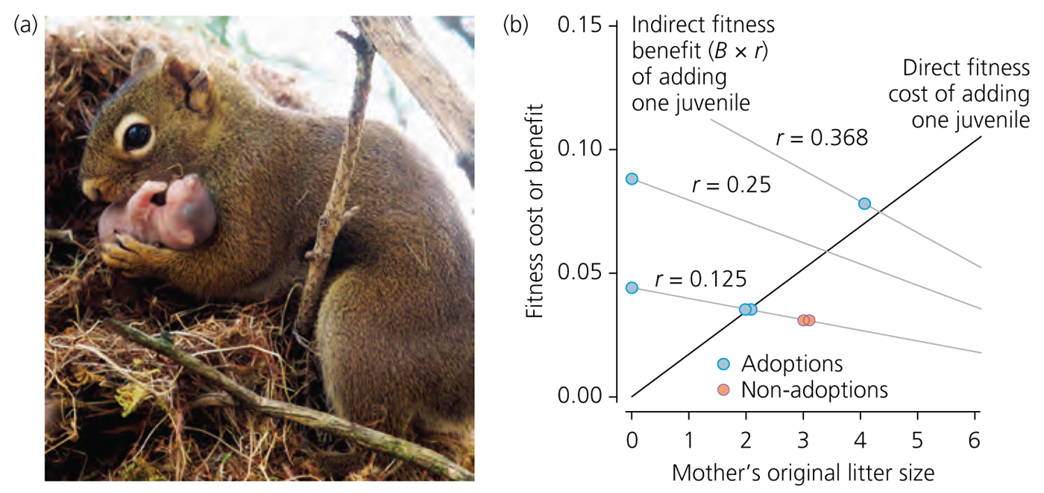
Adoption in Red Squirrels
Notes:
No litters were adapted by unrelated females
35 litters, 27 no relatives around and none adopted
of seven, five were adopted, fitting with Hamilton’s rule
Black line is the cost or benefit of adding another kit to the litter, and where the r lines intersect, is the breakeven point.

Slide 13
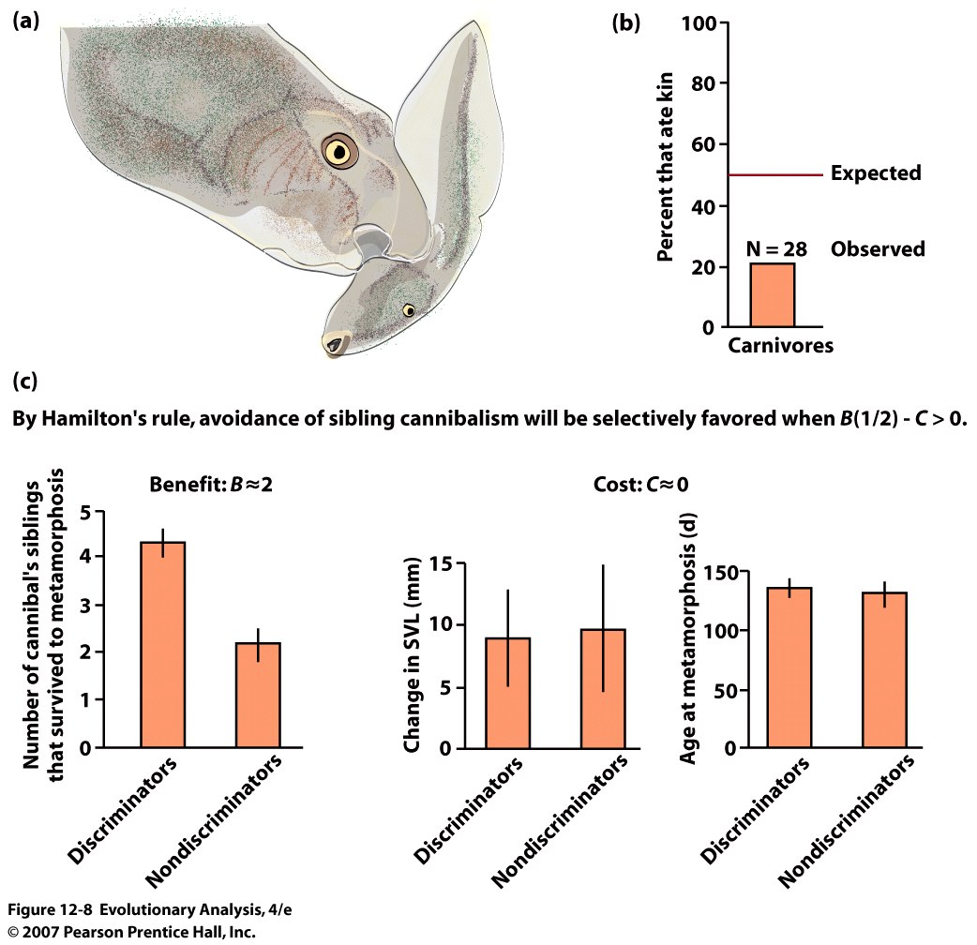
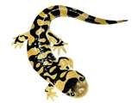
Kin-selected discrimination in cannibalistic tadpoles
and salamanders
Benefit
Notes:
Figure 12.8 Kin-selected discrimination in cannibalistic tadpoles and tiger salamanders
In spadefoot toads some tadpoles develop into carnivores and become cannibals. (b) Given a choice between eating siblings versus non-kin, most cannibals are discriminating and preferentially eat non-kin. From Pfennig (1999). (c) The same phenomenon occurs in tiger salamanders. Under semi-natural conditions, discriminating cannibals see twice as many siblings survive as nondiscriminating cannibals (left) but suffer negligible costs (center and right). The costs and benefits of discriminating tastes thus satisfy Hamilton's equation for kin selection. From Pfennig et al. (1999).
Plains Spadefoot Toads are nocturnal, and secretive. They spend most of the dryer seasons buried in the soil in estivation, typically only emerging during spring and fall rains. Breeding takes place in temporary pools of water left by rainfall, which requires the tadpoles to metamorphosize quickly, before the water dries up. Eggs, laid in clutches numbering from 10-250, often hatch within 48 hours of being laid, and the larvae can change into toadlets in as little as two weeks. The tadpoles exhibit phenotypic plasticity, with some tadpoles changing from an omnivorous morphology into a cannibalistic carnivorous morph with oversized jaw muscles and a pronged beak. A recent study has shown that in some cases female spadefoot toads will choose to mate with Spea multiplicata rather than with males of their own species, if the resulting hybrid tadpole would have higher chances of survival. [1]

Slide 14
Bequeathing Wealth in Vancouver
46.5 % to offspring and siblings (r = 0.5)
but most to offspring
8.3 % to grandkids, nieces and nephews (r = 0.25)
0.6% to cousins (r = 0.125)
Notes:
However could reflect custom culture in 1 community

Slide 15
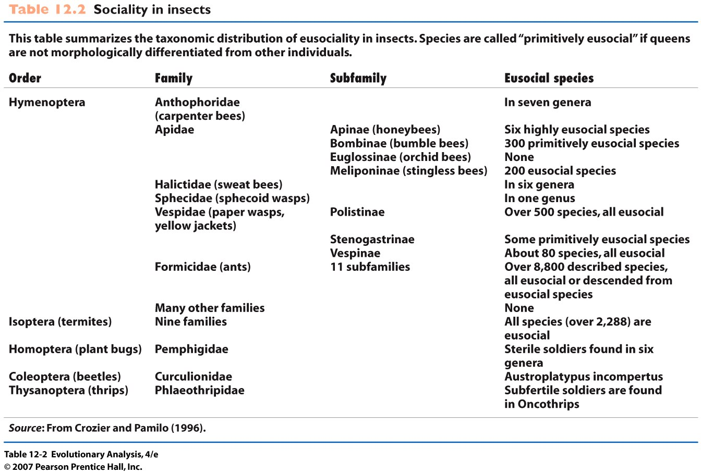
IV. Special case of Sociality
True or Eusociality =
1. overlap in generations between parents and offspring
2. cooperative brood care
3. specialized castes of nonreproductive individuals
Notes:
Table 12.2 Sociality in insects

Slide 16
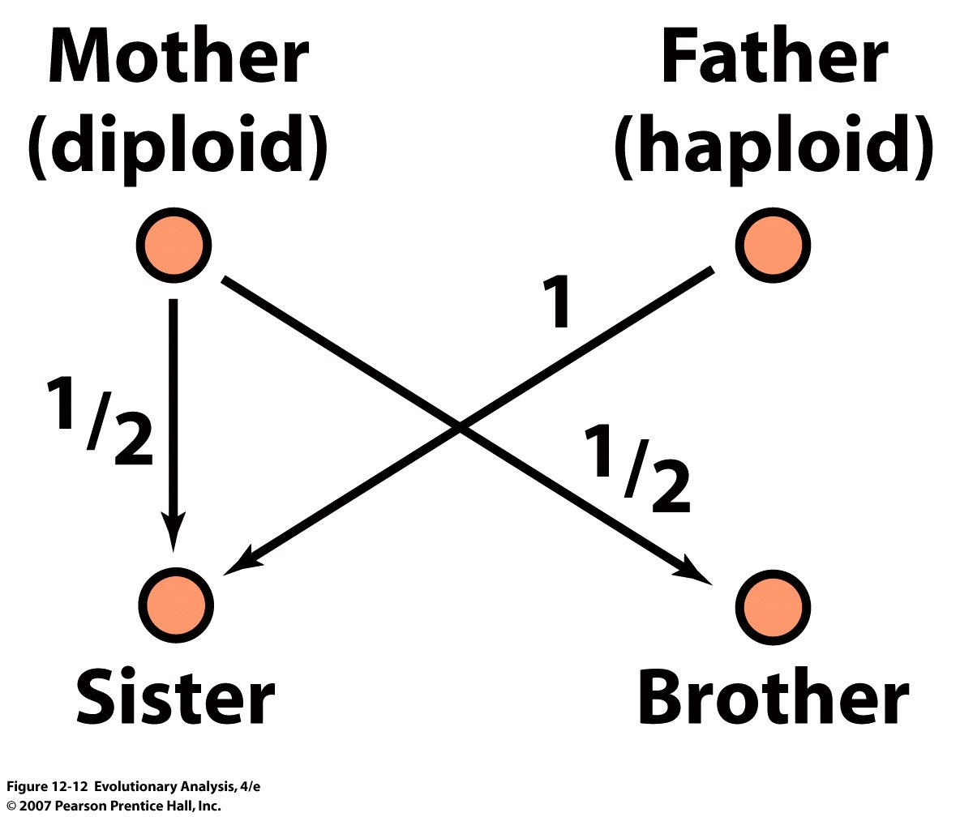
Haplodiploidy produces unusual
coefficients of relationship
Notes:
Figure 12.12 Haplodiploidy produces unusual coefficients of relationship
The arrows describe the paths by which genes can be identical by descent in hymenopterans. Note that there is no path of shared descent between sisters and brothers through their father, because males have no father. NOTE THAT MALES HAVE NO PATH OF DESCENT THROUGH FATHER

Slide 17
Haplo-diploidy and Sister-Sister relationship
Sisters on average
share ½ genes
through mother
& all of their
genes through
father
(1/2 + 1)/2 = ¾
Or
¼ + ½ = 3/4
mother
father
r = ½ ½ 1
1
sister
sister

Slide 18
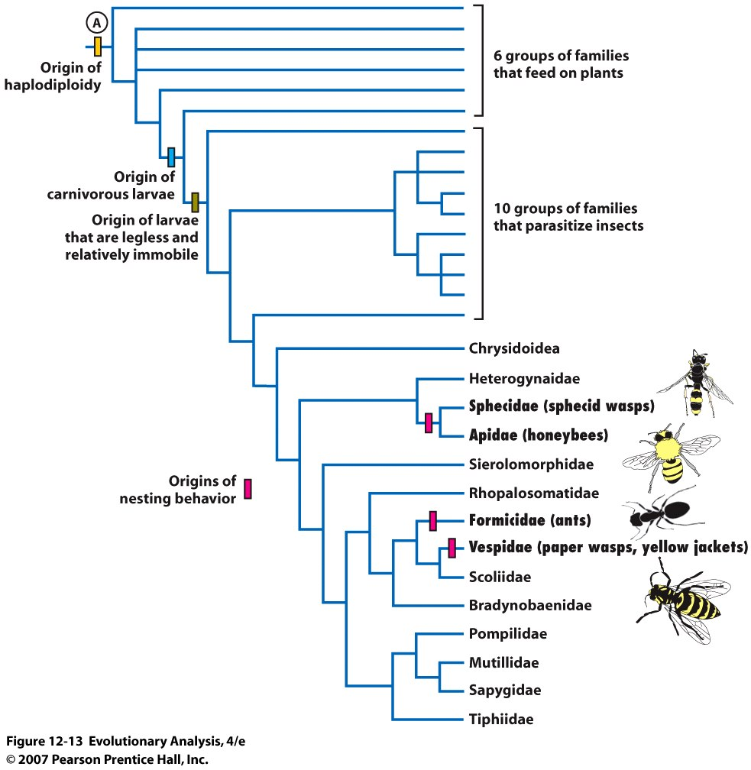
phylogeny of the hymenoptera
Origins of complex
nesting behaviour
Notes:
Figure 12.13 A phylogeny of the hymenoptera
The taxa at the tips of this tree are either families or groups of families. Families that include eusocial species are indicated in bold type. (Not all of the species in these families are eusocial, however.) The colored boxes indicate points where certain key traits evolved. Modified from Hunt (1999).
Other eusocial animals that are not haplo-diploid have complex, fortress like nests. High Predation, Constant care of Young, all are components that lead to sharing and evolution of eusociality

Slide 19
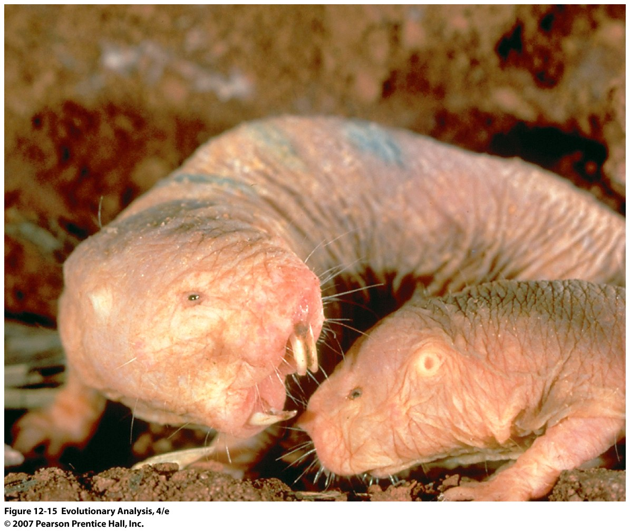
Naked mole-rats have highly inbred colonies
Notes:
Figure 12.15 Naked mole-rats
This photo shows a naked mole-rat queen threatening a worker. For superb introductions to the biology of naked mole-rats, see Honeycutt (1992) and Sherman et al. (1992).

Slide 20
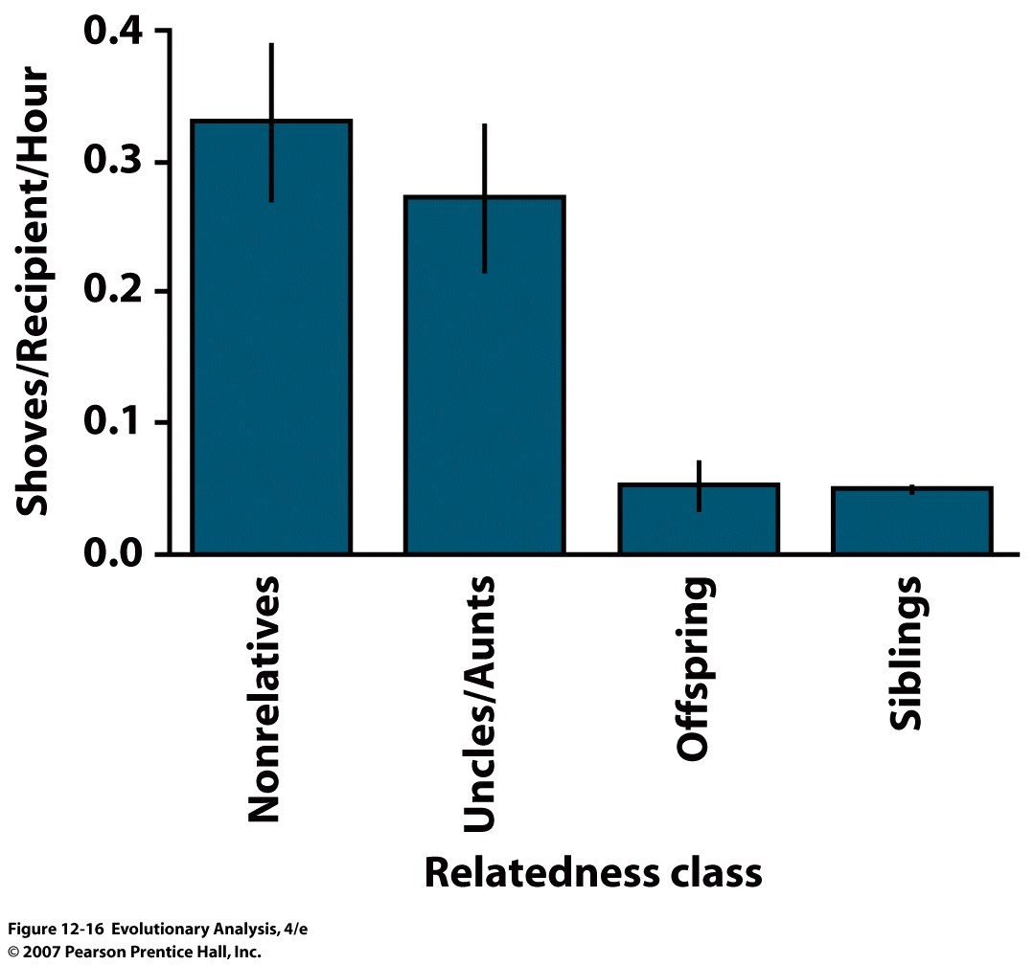
Naked mole-rat queens preferentially shove nonrelatives
Notes:
Figure 12.16 Naked mole-rat queens preferentially shove nonrelatives
These data were collected from a captive colony of naked mole-rats. The bars indicate the average and standard errors of shoves given to different kin classes by a queen called three-bars. There is a statistically significant difference between shoving rates for nonrelatives and uncles/aunts versus the two closer kin classes. From Reeve and Sherman (1991).
Inbreeding also for termites

Slide 21
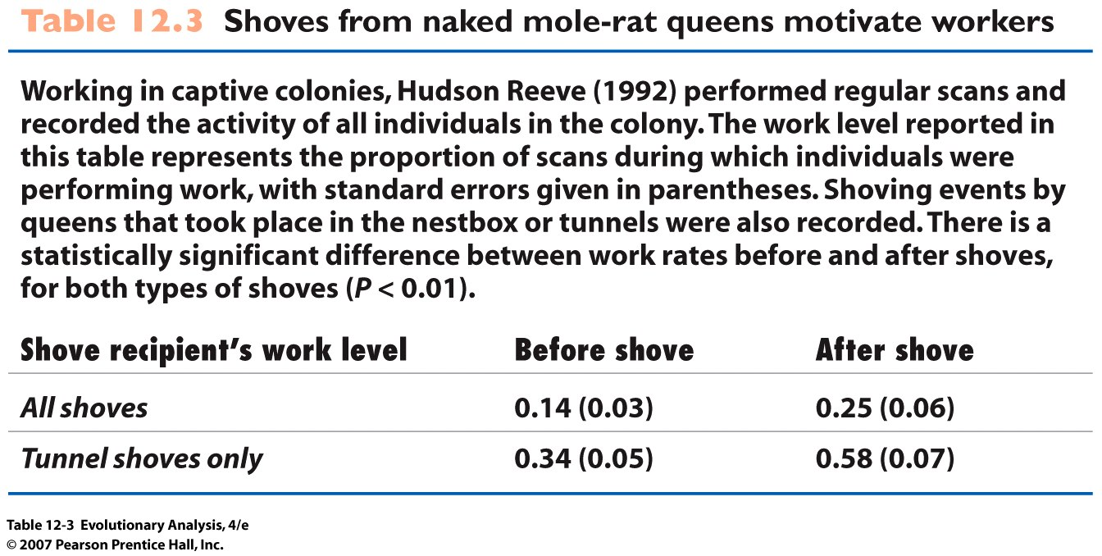
Notes:
Table 12.3 Shoves from naked mole-rat queens motivate workers

Slide 22
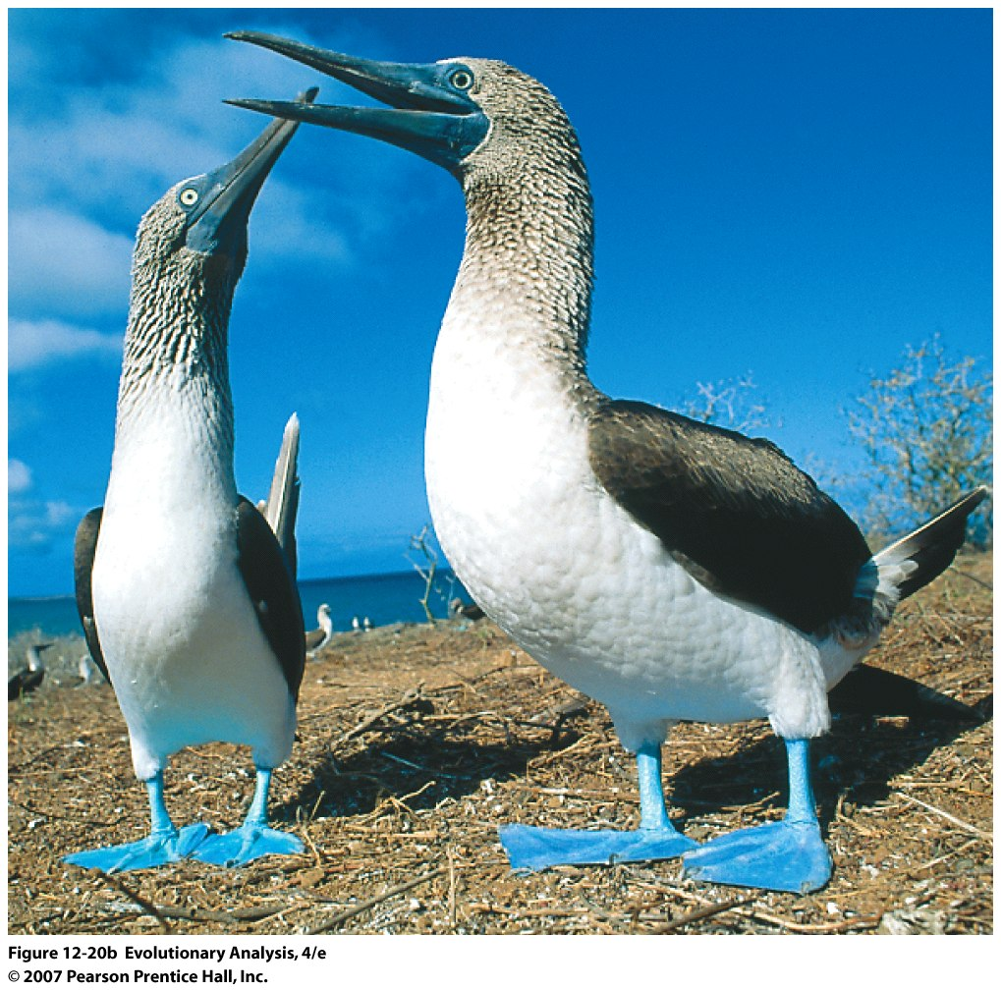
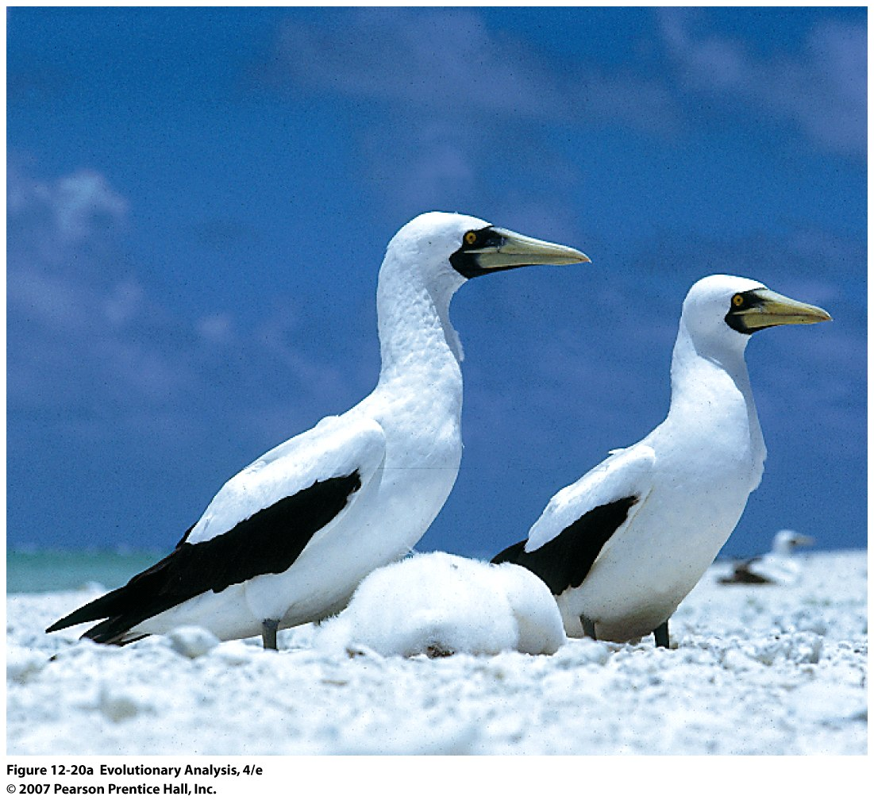
V. Siblicide and Parent-Offspring
Conflict
Masked boobies
Blue-footed boobies
Older sib sometimes
pushes sib from nest
Older sib always pushes sib from nest
Notes:
Figure 12.20a Masked and blue-footed boobies
These photos show masked boobies (left) and blue-footed boobies (right). The two species nest in adjacent colonies at the study site established by Lougheed and Anderson in the Galápagos Islands off the northwest coast of South America.

Slide 23
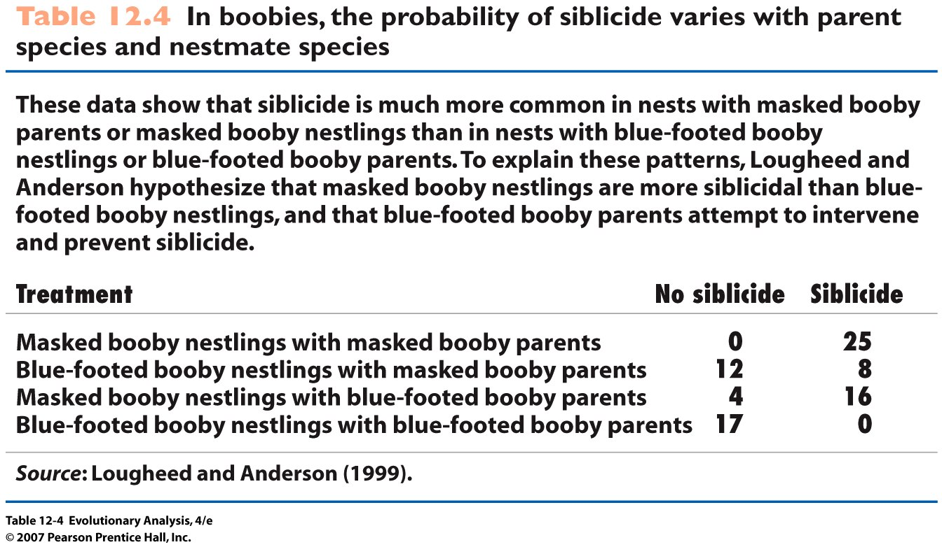
Notes:
Table 12.4 In boobies, the probability of siblicide varies with parent species and nestmate species

Slide 24
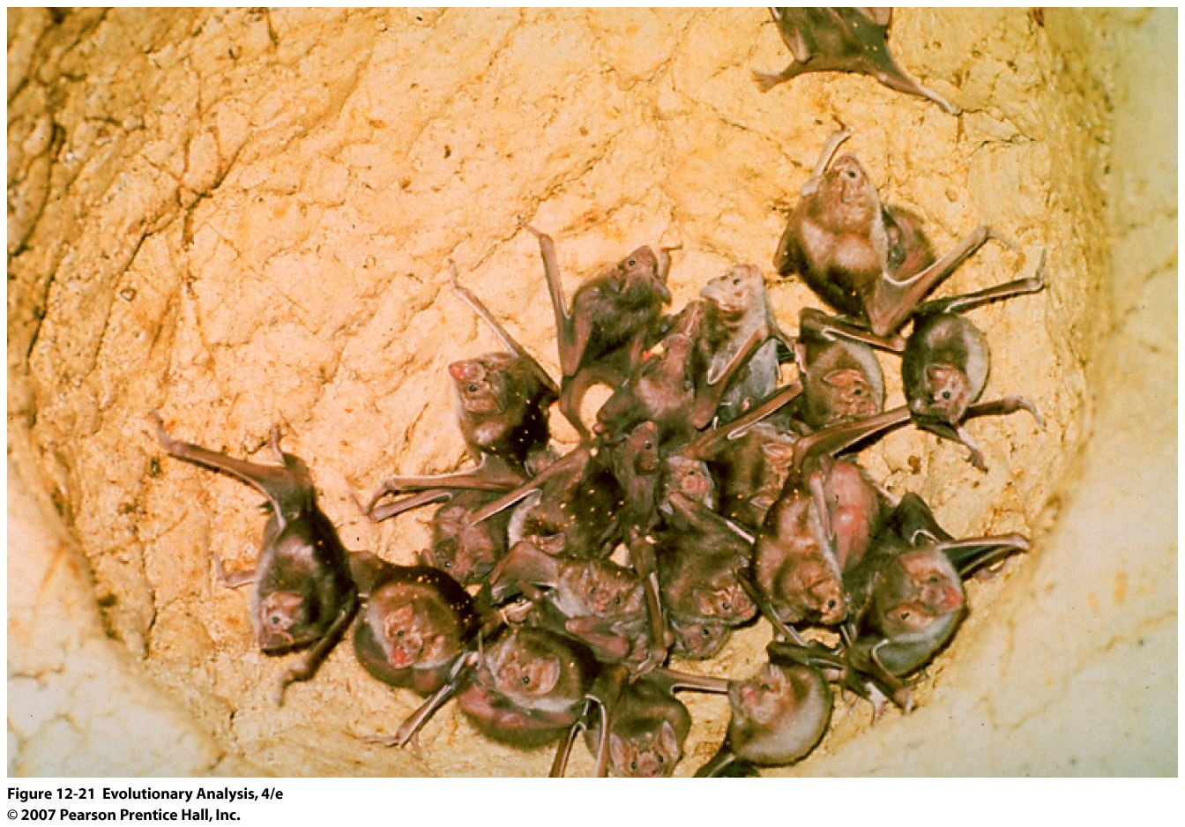
VI. Reciprocal Altruism
Vampire bats
This photo shows a group of vampire bats roosting in a hollow tree
Cooperative behavior among non kin
Notes:
Figure 12.21 Vampire bats
This photo shows a group of vampire bats roosting in a hollow tree.

Slide 25
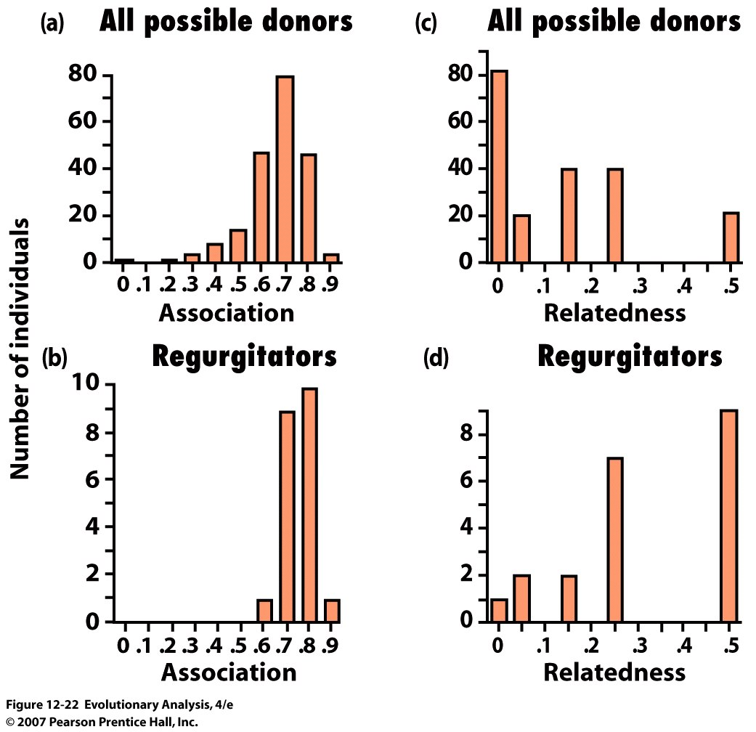
Also fed nest mates that had fed them
Notes:
Figure 12.22 Association, relatedness, and altruism in vampire bats
These histograms plot the total number of bat-bat pairs at Gerald Wilkinson's study site versus their (a) degree of association for all potential blood donors in the roost, (b) degree of association for blood-sharing pairs who are not related as mother-offspring, (c) coefficient of relatedness for all potential blood donors in the roost, and (d) coefficient of relatedness for blood-sharing pairs who were not related as mother-offspring. The visual impression in these figures is that regurgitators are more likely to be related and more likely to be roostmates than the general population. This is confirmed by a statistical procedure called a stepwise logistic regression. Both relatedness and association affect the probability of blood-sharing. From Wilkinson (1984).

Slide 26
Conclusion
Cooperative behaviors are widespread
Inclusive fitness
(B x r) – C > 0
Haplo-diploidy
Siblicide
Reciprocal altruism (Tit for Tat)
Other interesting topics: P-O conflict, sex ratio evolution, greenbeard alleles

